Slide 1
Enterprise Software Dev.
Software Project Visualizer
Yu-Teh Lu, Mingpu Yu, Jialin Tian

Slide 2
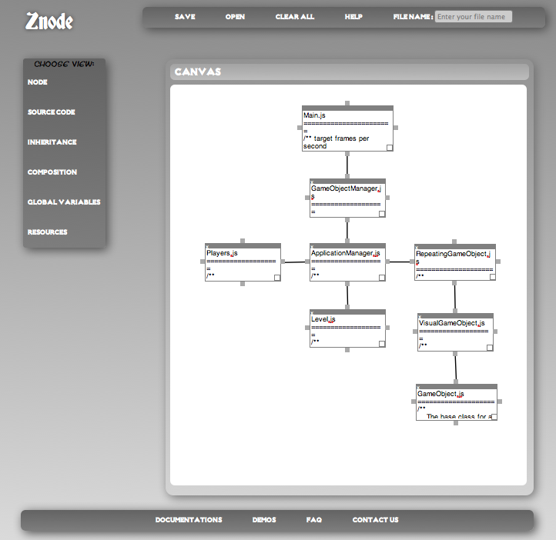
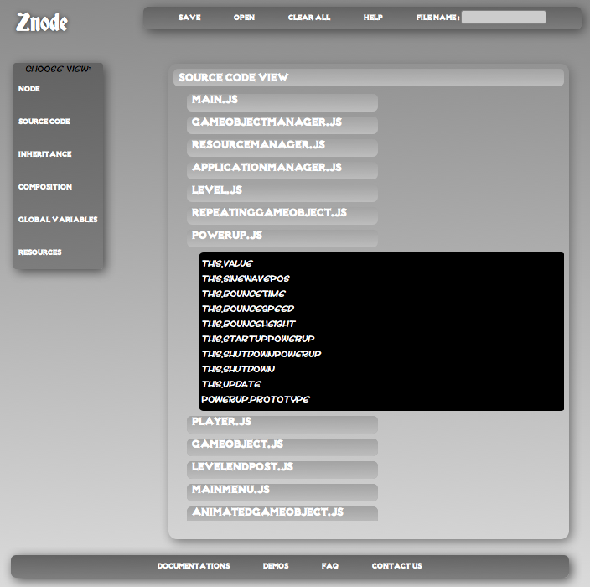
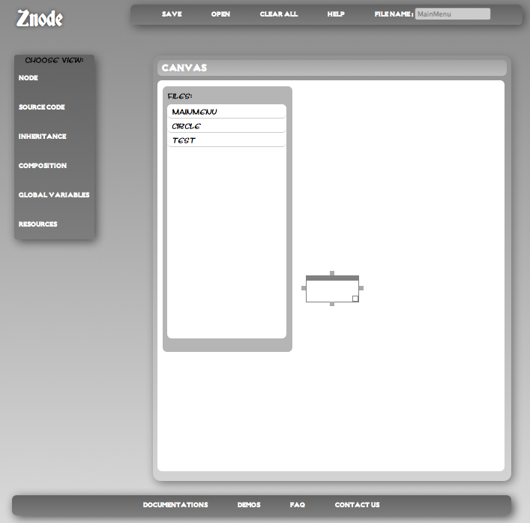
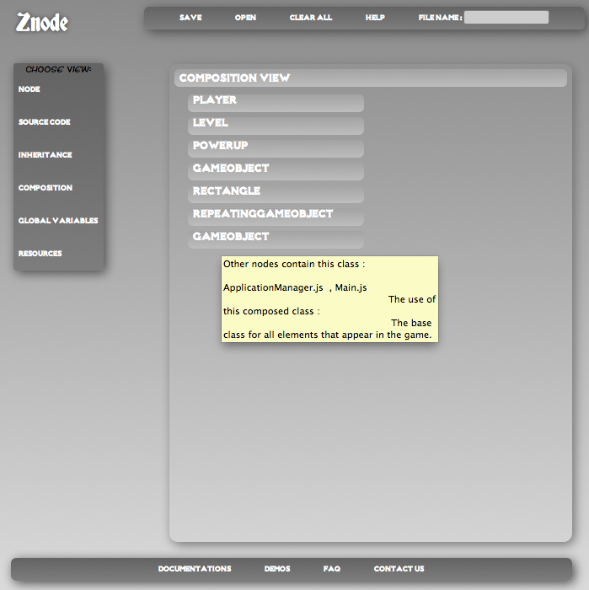

Slide 3
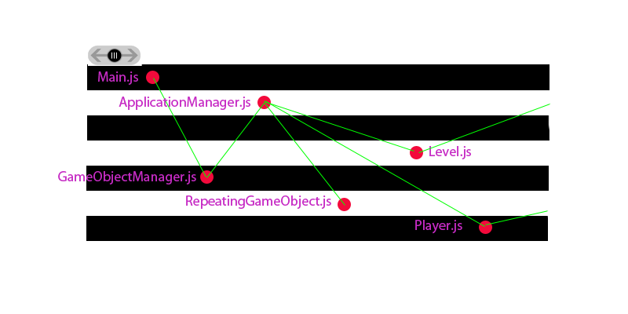
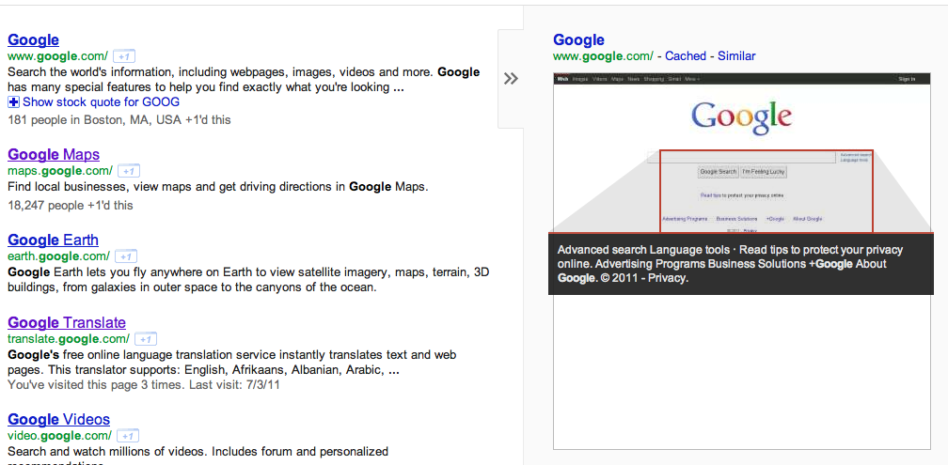
Additional Features
Inheritance View
Slider with 2D horizontal road
Show the associations of each class
Resources View
Like the quick view in Google search
When mouse hover on the tag, it will automatically show the snapshot

Slide 4
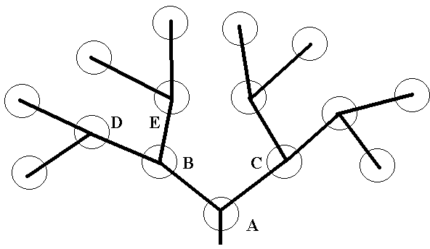
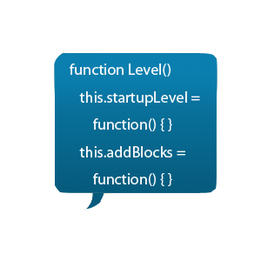
Additional Features
Global Variables View
Tree mapping
Function View
Zoom-in and pop-out dialog

